Slide 1
高性能计算导论
HW 1&2 答案解析
2019/04

Slide 2
目录
作业一
作业二

Slide 3
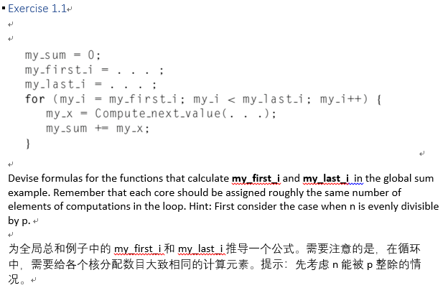
1.1

Slide 4
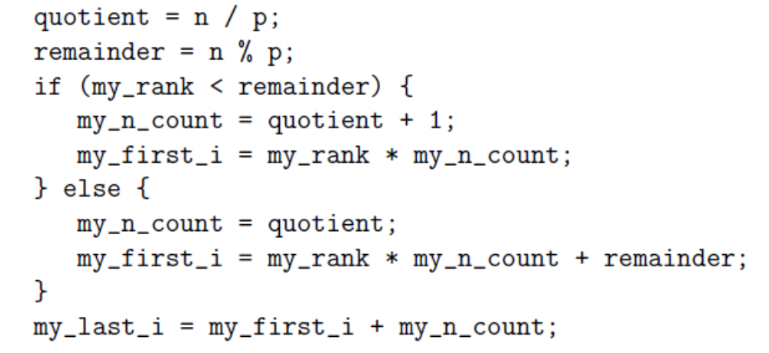
1.1
最佳答案
思路：不同的核之间任务分配最多相差1个
小于余数的分配quotient+1个，大于余数的分配quotient个
请注意边界条件

Slide 5
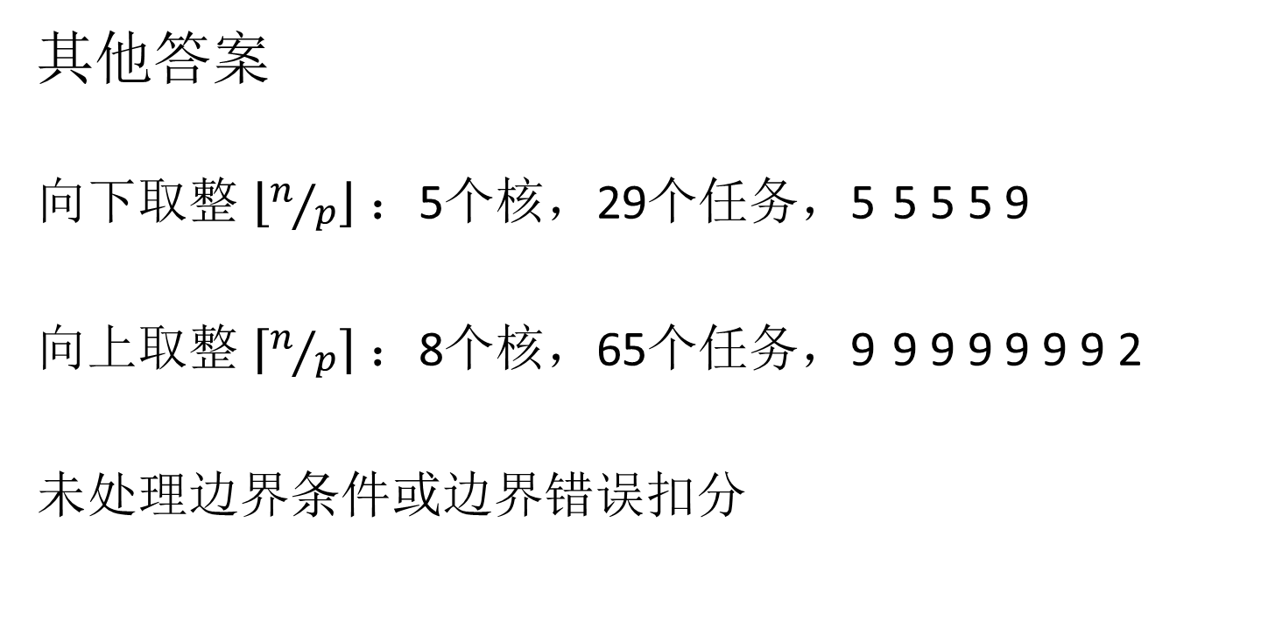
1.1
其他答案
向下取整 $\left\lfloor n/p\right\rfloor$ ：5个核，29个任务，5 5 5 5 9
向上取整 $\left\lceil n/p\right\rceil$ ：8个核，65个任务，9 9 9 9 9 9 9 2
未处理边界条件或边界错误扣分

Slide 6
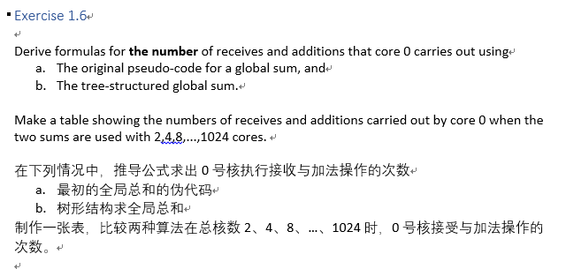
1.6

Slide 7
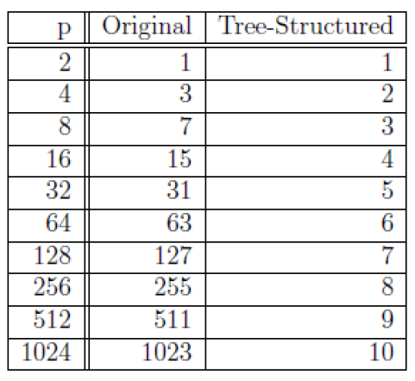
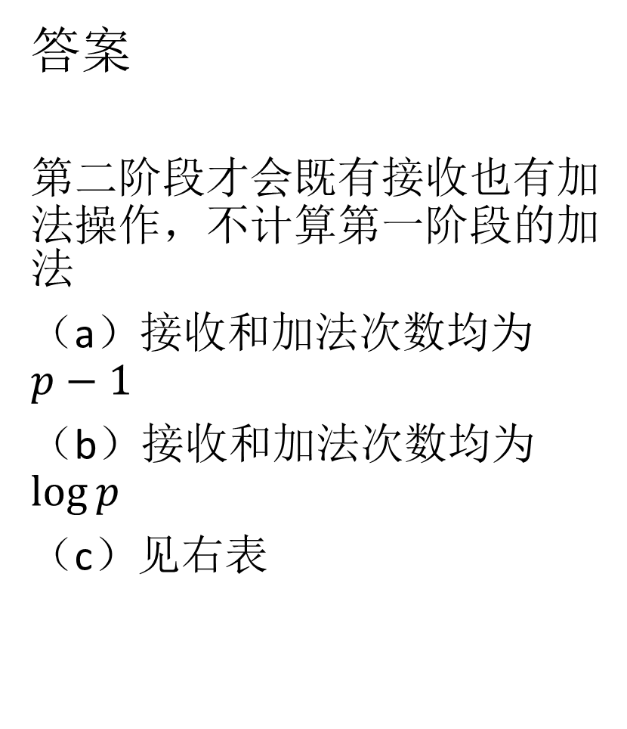
1.6
答案
第二阶段才会既有接收也有加法操作，不计算第一阶段的加法
（a）接收和加法次数均为 $p−1$
（b）接收和加法次数均为$\log{p}$
（c）见右表

Slide 8
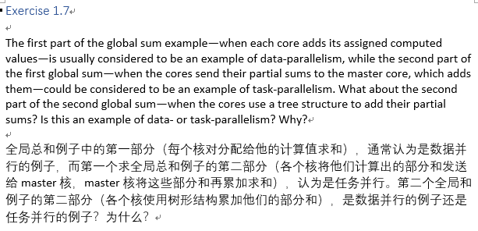
1.7

Slide 9
1.7
答案
The example is a combination of task- and data-parallelism. In each phase of the tree-structured global sum, the cores are computing partial sums. This can be seen as data-parallelism. Also, in each phase, there are two types of tasks. Some cores are sending their sums and some are receiving another cores partial sum. This can be seen as task-parallelism.

Slide 10
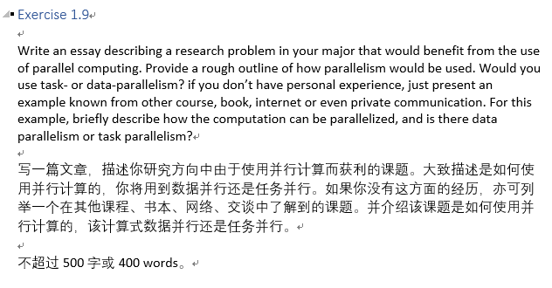
1.9

Slide 11
1.9
优秀范例
计算机图形学，光子映射算法渲染场景
GPU训练深度学习网络，英伟达CUDA
高性能计算在气象领域应用

Slide 12
目录
作业一
作业二

Slide 13
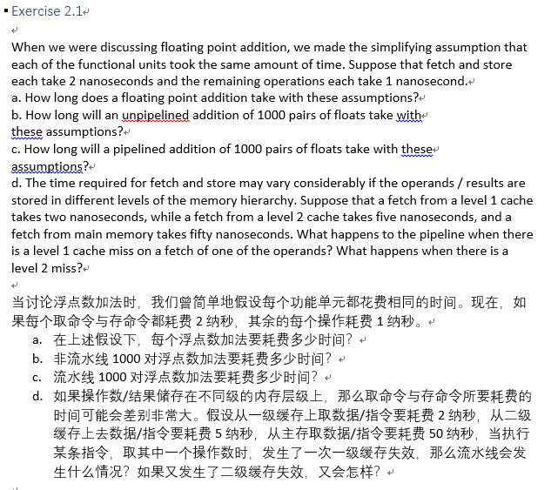
2.1

Slide 14
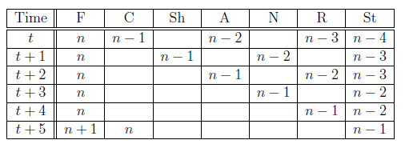
2.1
答案
（a）浮点数加法共有7个步骤，9ns
（b）9000ns
（c）9+999*2=2007ns
（d）从二级缓存取数据或指令指的是该取指令全部的时间，不需要从二级取到一级再从一级取。一级miss多3ns，二级miss多48ns

Slide 15
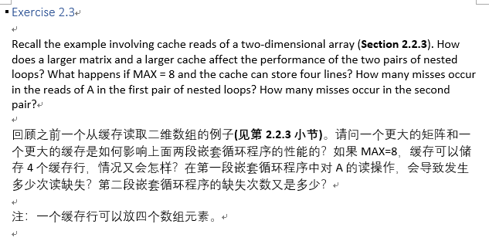
2.3

Slide 16
2.3
答案
（a）更大的矩阵会使得miss频繁，性能下降；更大的缓存反之（也可以结合实际数值说明）
（b）MAX=8时，第一段嵌套16次读miss；第二段嵌套64次读miss

Slide 17
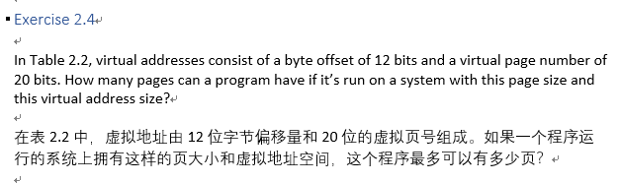

2.4
答案
$$2^{20}$$

Slide 18
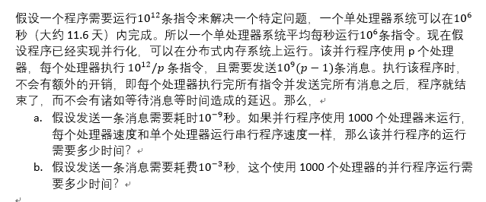
2.10

Slide 19
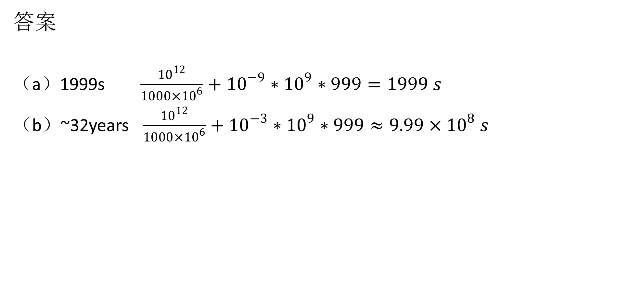
2.10
答案
（a）1999s $\frac{{10}^{12}}{1000×{10}^{6}}+{10}^{−9}∗{10}^{9}∗999=1999 s$
（b）~32years $\frac{{10}^{12}}{1000×{10}^{6}}+{10}^{−3}∗{10}^{9}∗999≈9.99×{10}^{8} s$

Slide 20
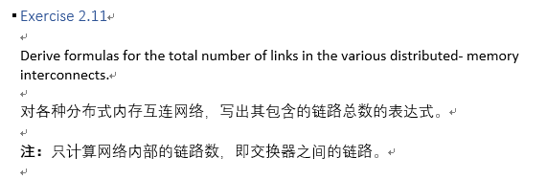
2.11

Slide 21
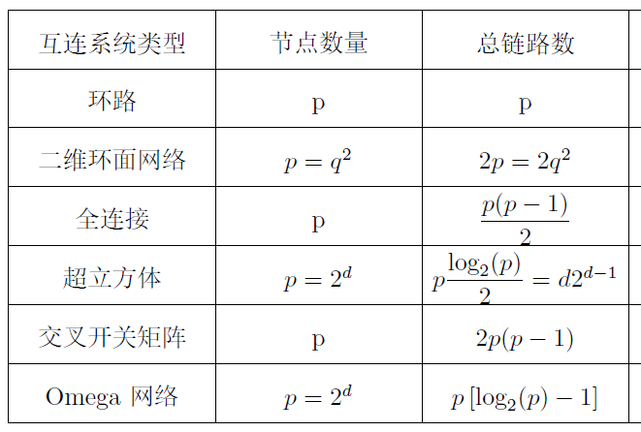
2.11
答案

Slide 22
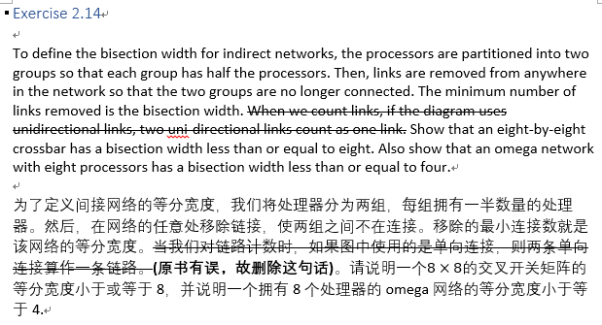
2.14

Slide 23
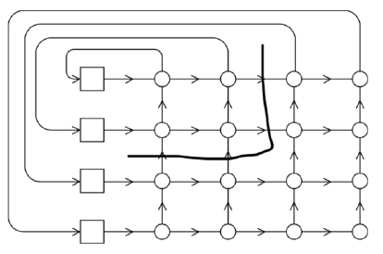
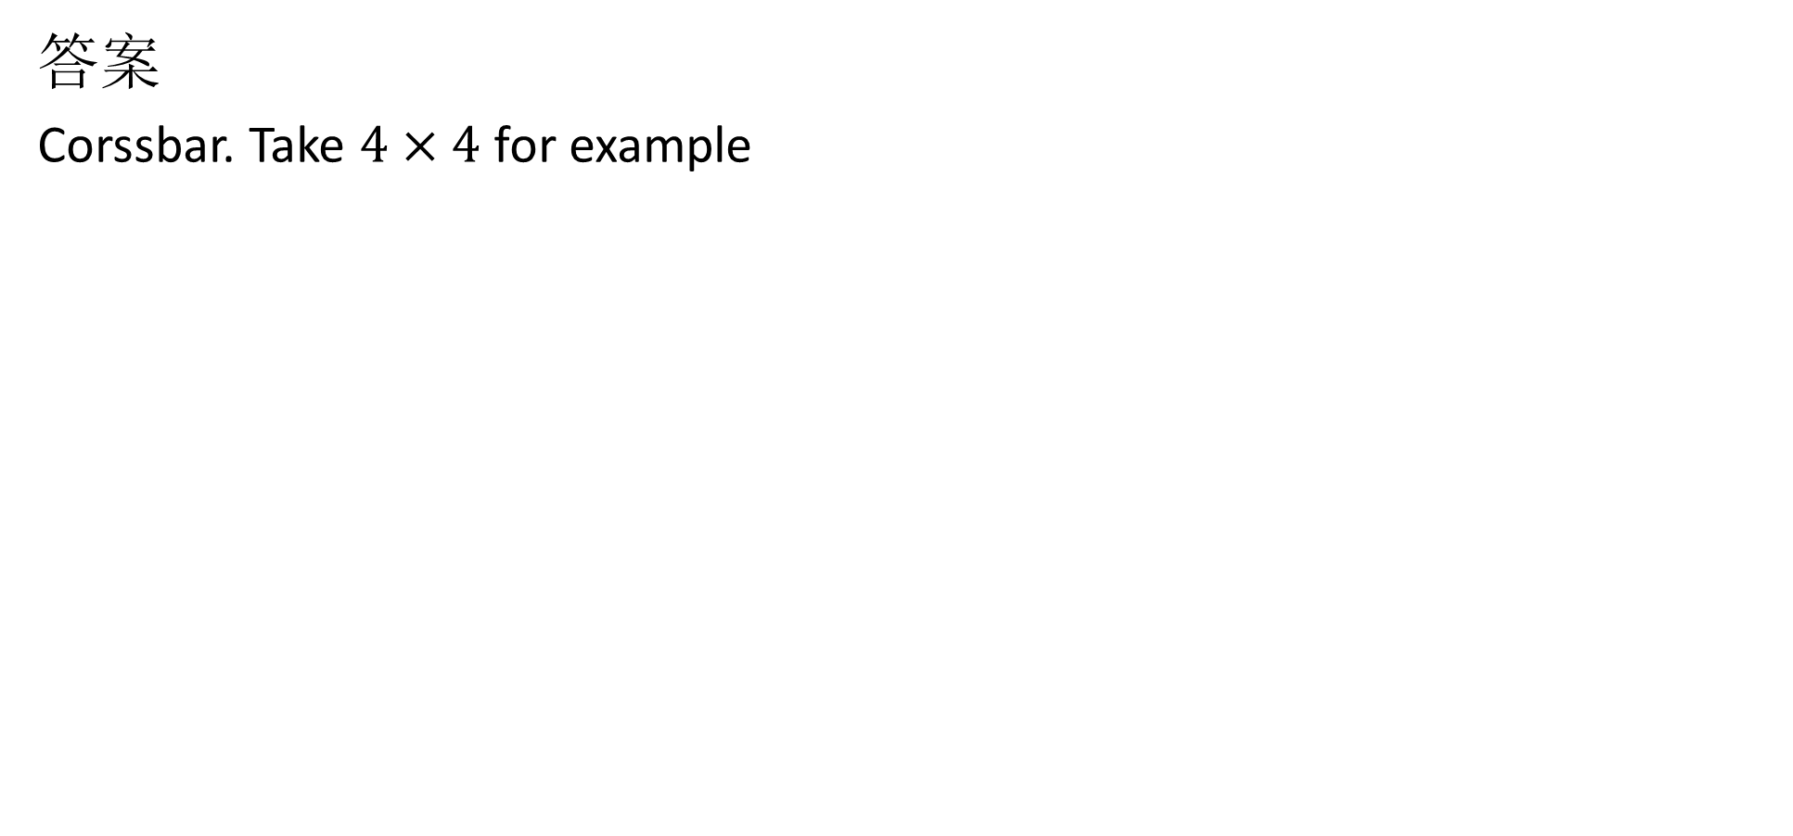
2.14
答案
Corssbar. Take $4×4$ for example

Slide 24
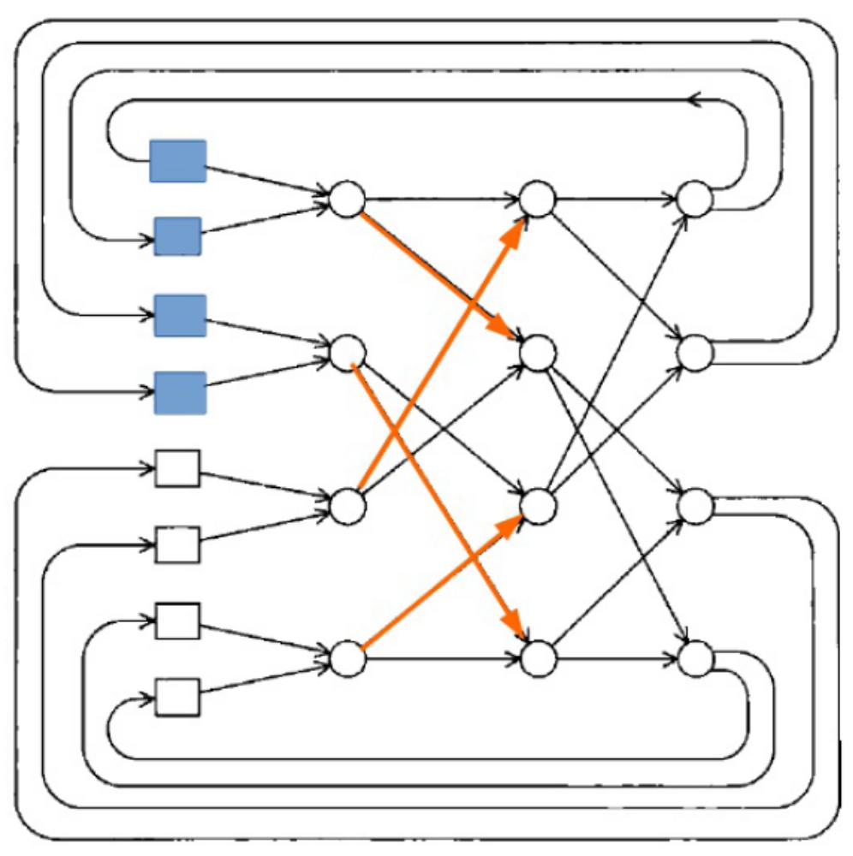
2.14
答案
Omega

Slide 25
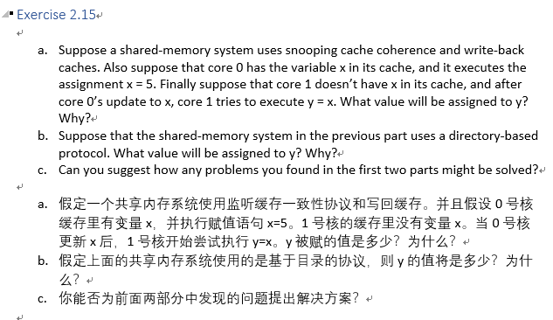
2.15

Slide 26
2.15
答案
（a）Since x is not in core 1s cache, the invalidation that core 0 sends wont have any effect on its cache. Furthermore, since the system uses write-back cache, when core 1 loads the line containing x it may load a line containing the old value of x. So the assignment y = x might assign a value x had before the assignment x = 5 was executed.
（b）In a directory-based system, when core 0 executes the assignment it will invalidate the line containing x in main memory by notifying the directory. The problem here is that core 1 may load the line containing x before the directory has entry has been invalidated.
（c）On a read miss to the local cache, the read request is broadcast on the bus. All cache controllers monitor the bus. If one has cached that address and it is in the state "dirty", it changes the state to "valid" and sends the copy to requesting node. The "valid" state means that the cache line is current. (From Wikipedia “Bus snooping”)

Slide 27
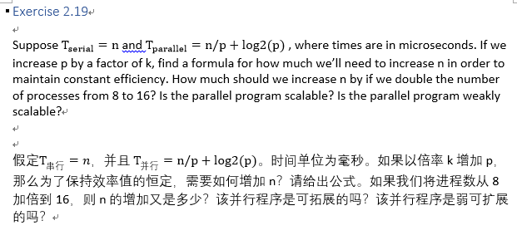
2.19

Slide 28
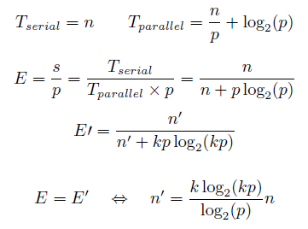
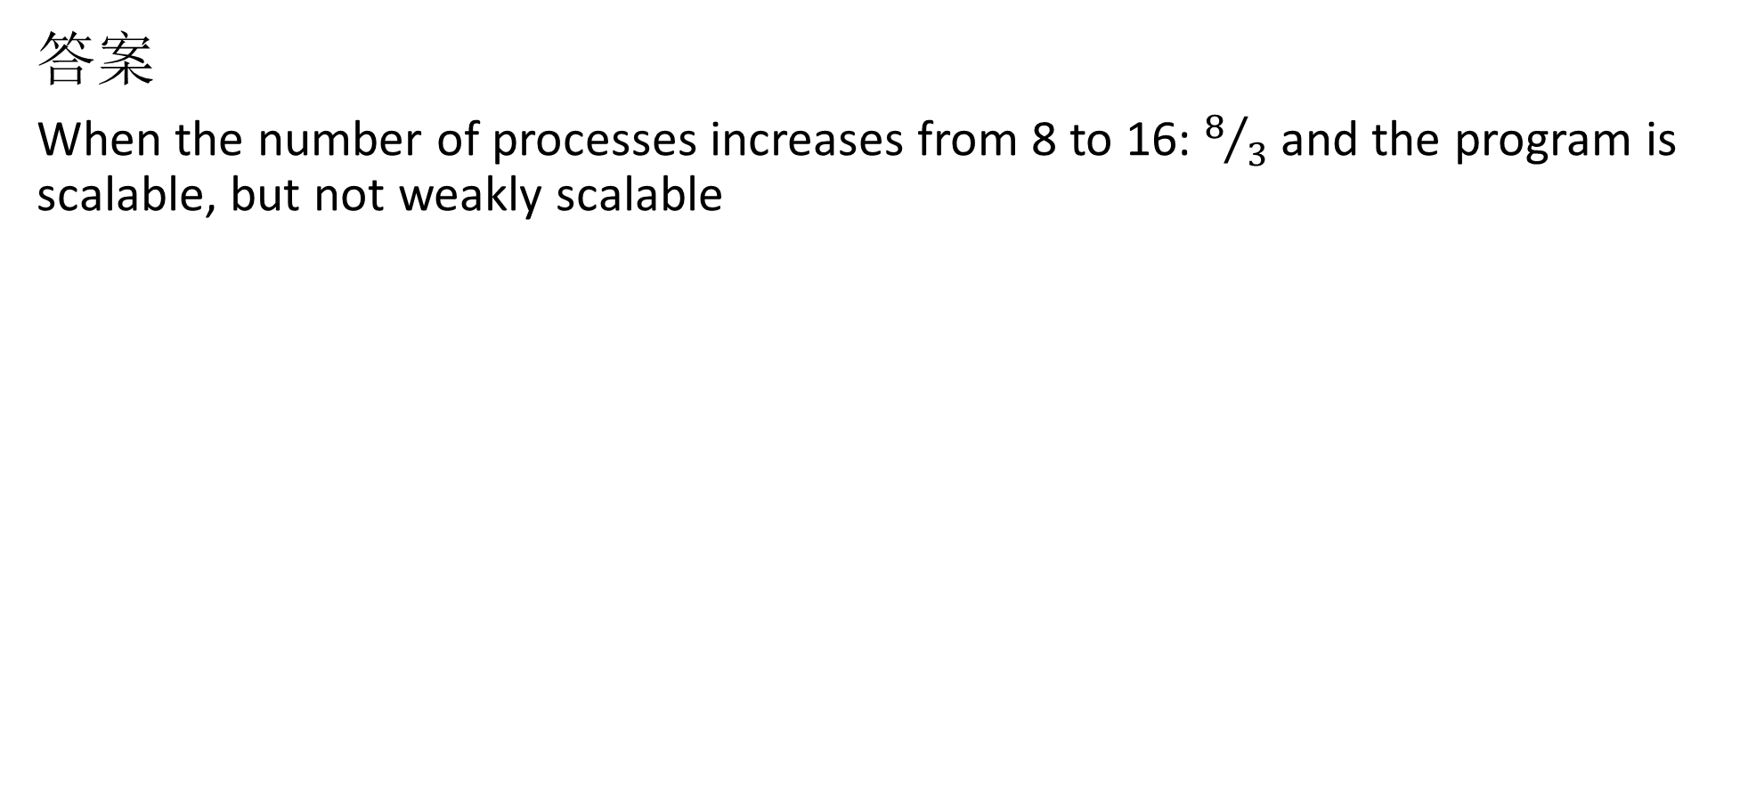
2.19
答案
When the number of processes increases from 8 to 16: $8/3$ and the program is scalable, but not weakly scalable

